Slide 2
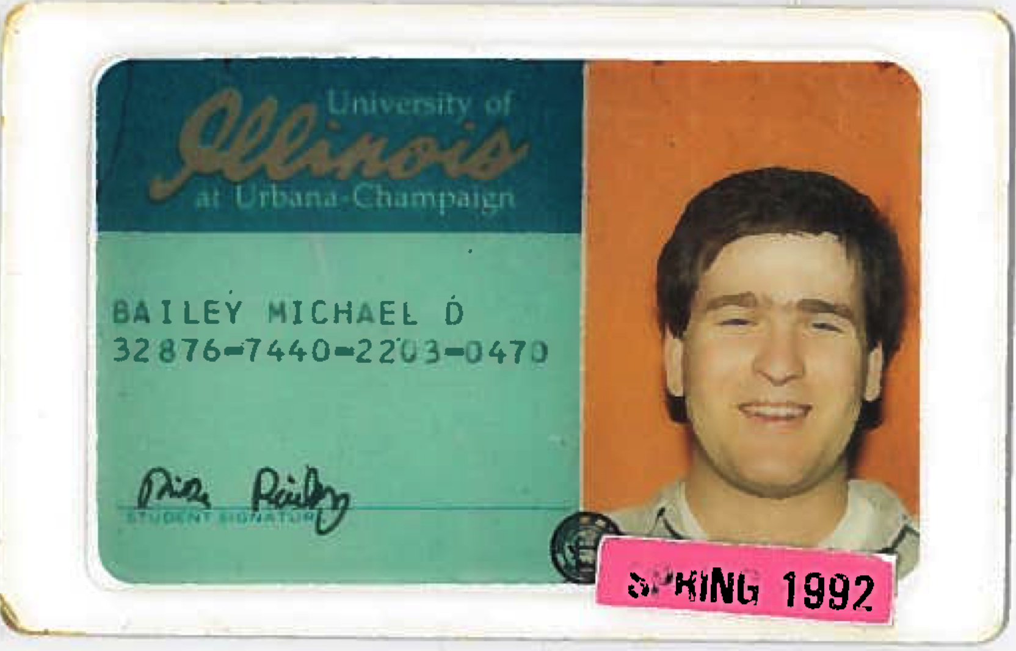

Slide 3
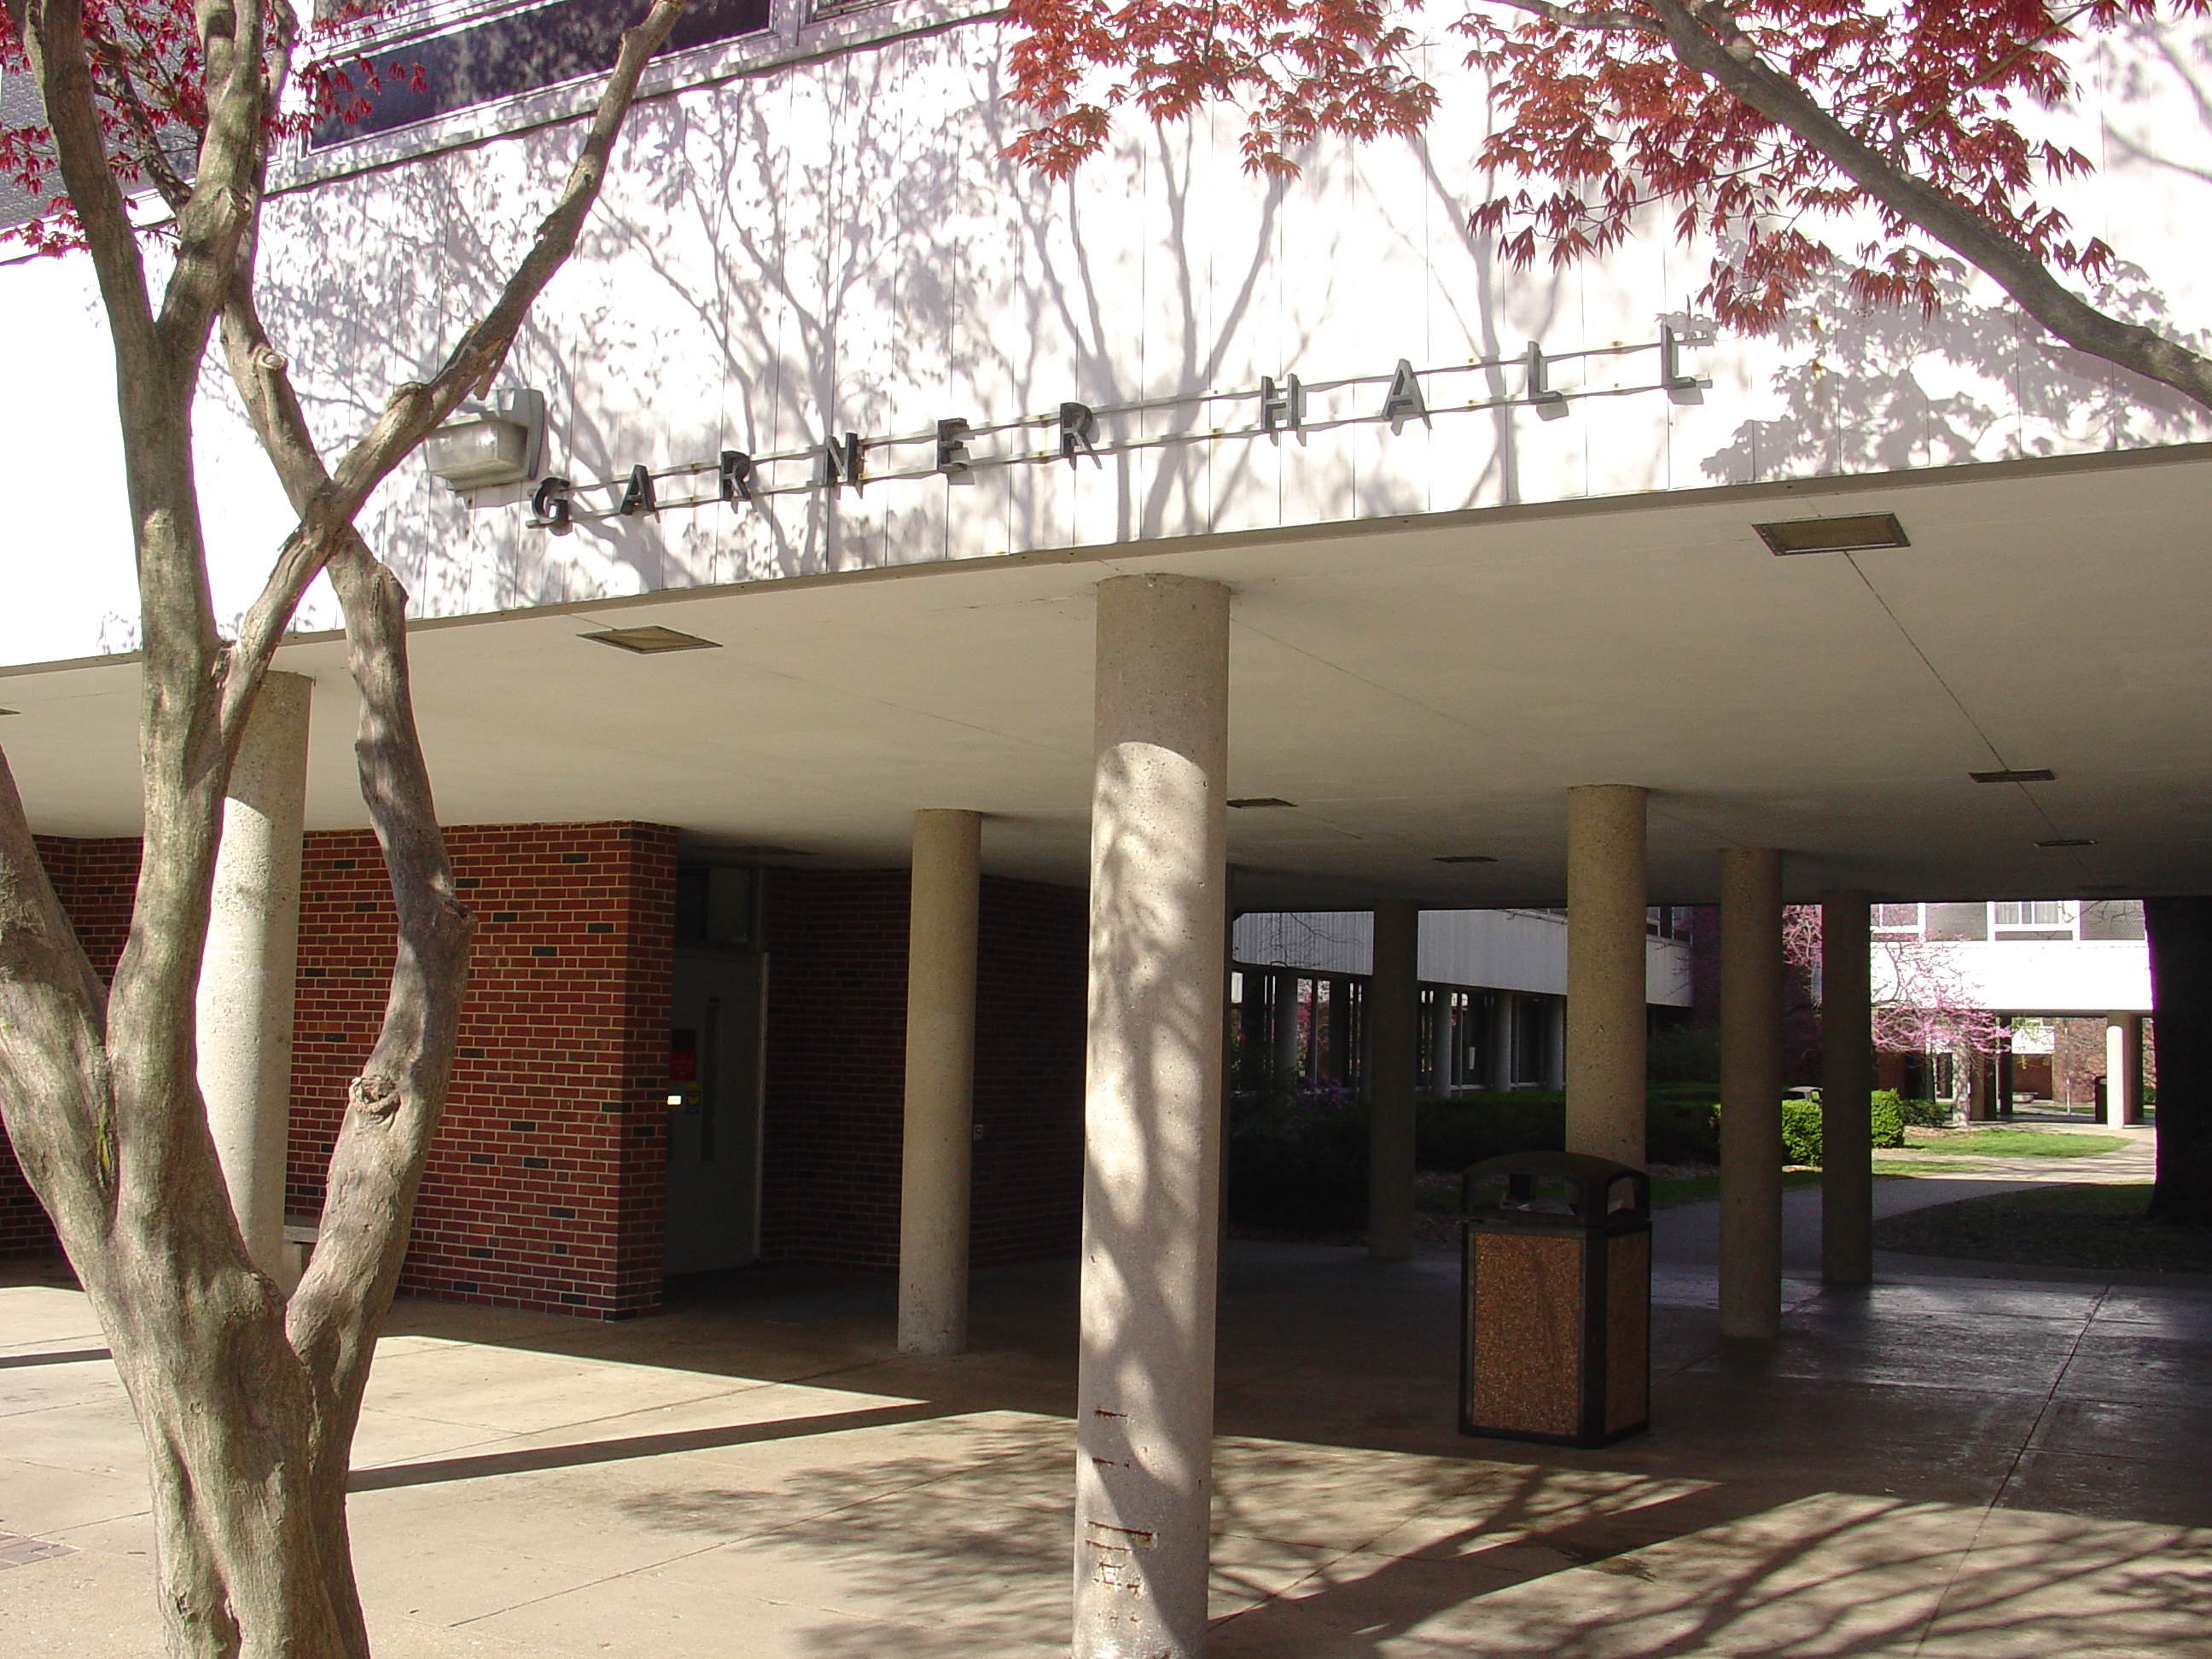

Slide 4
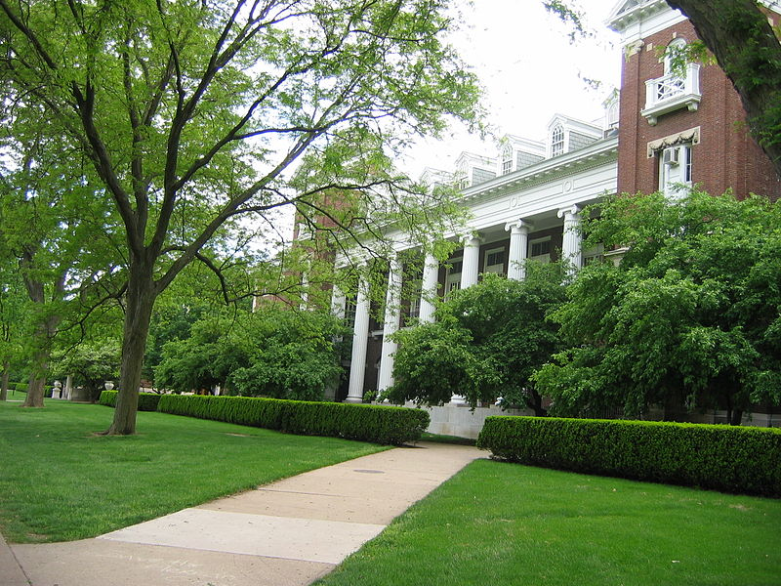

Slide 5
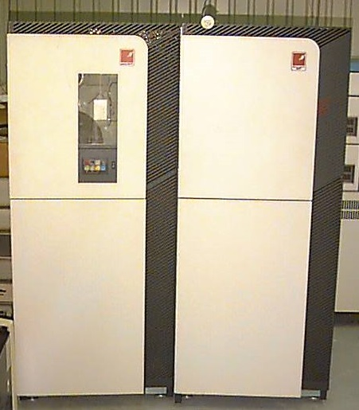

Slide 6
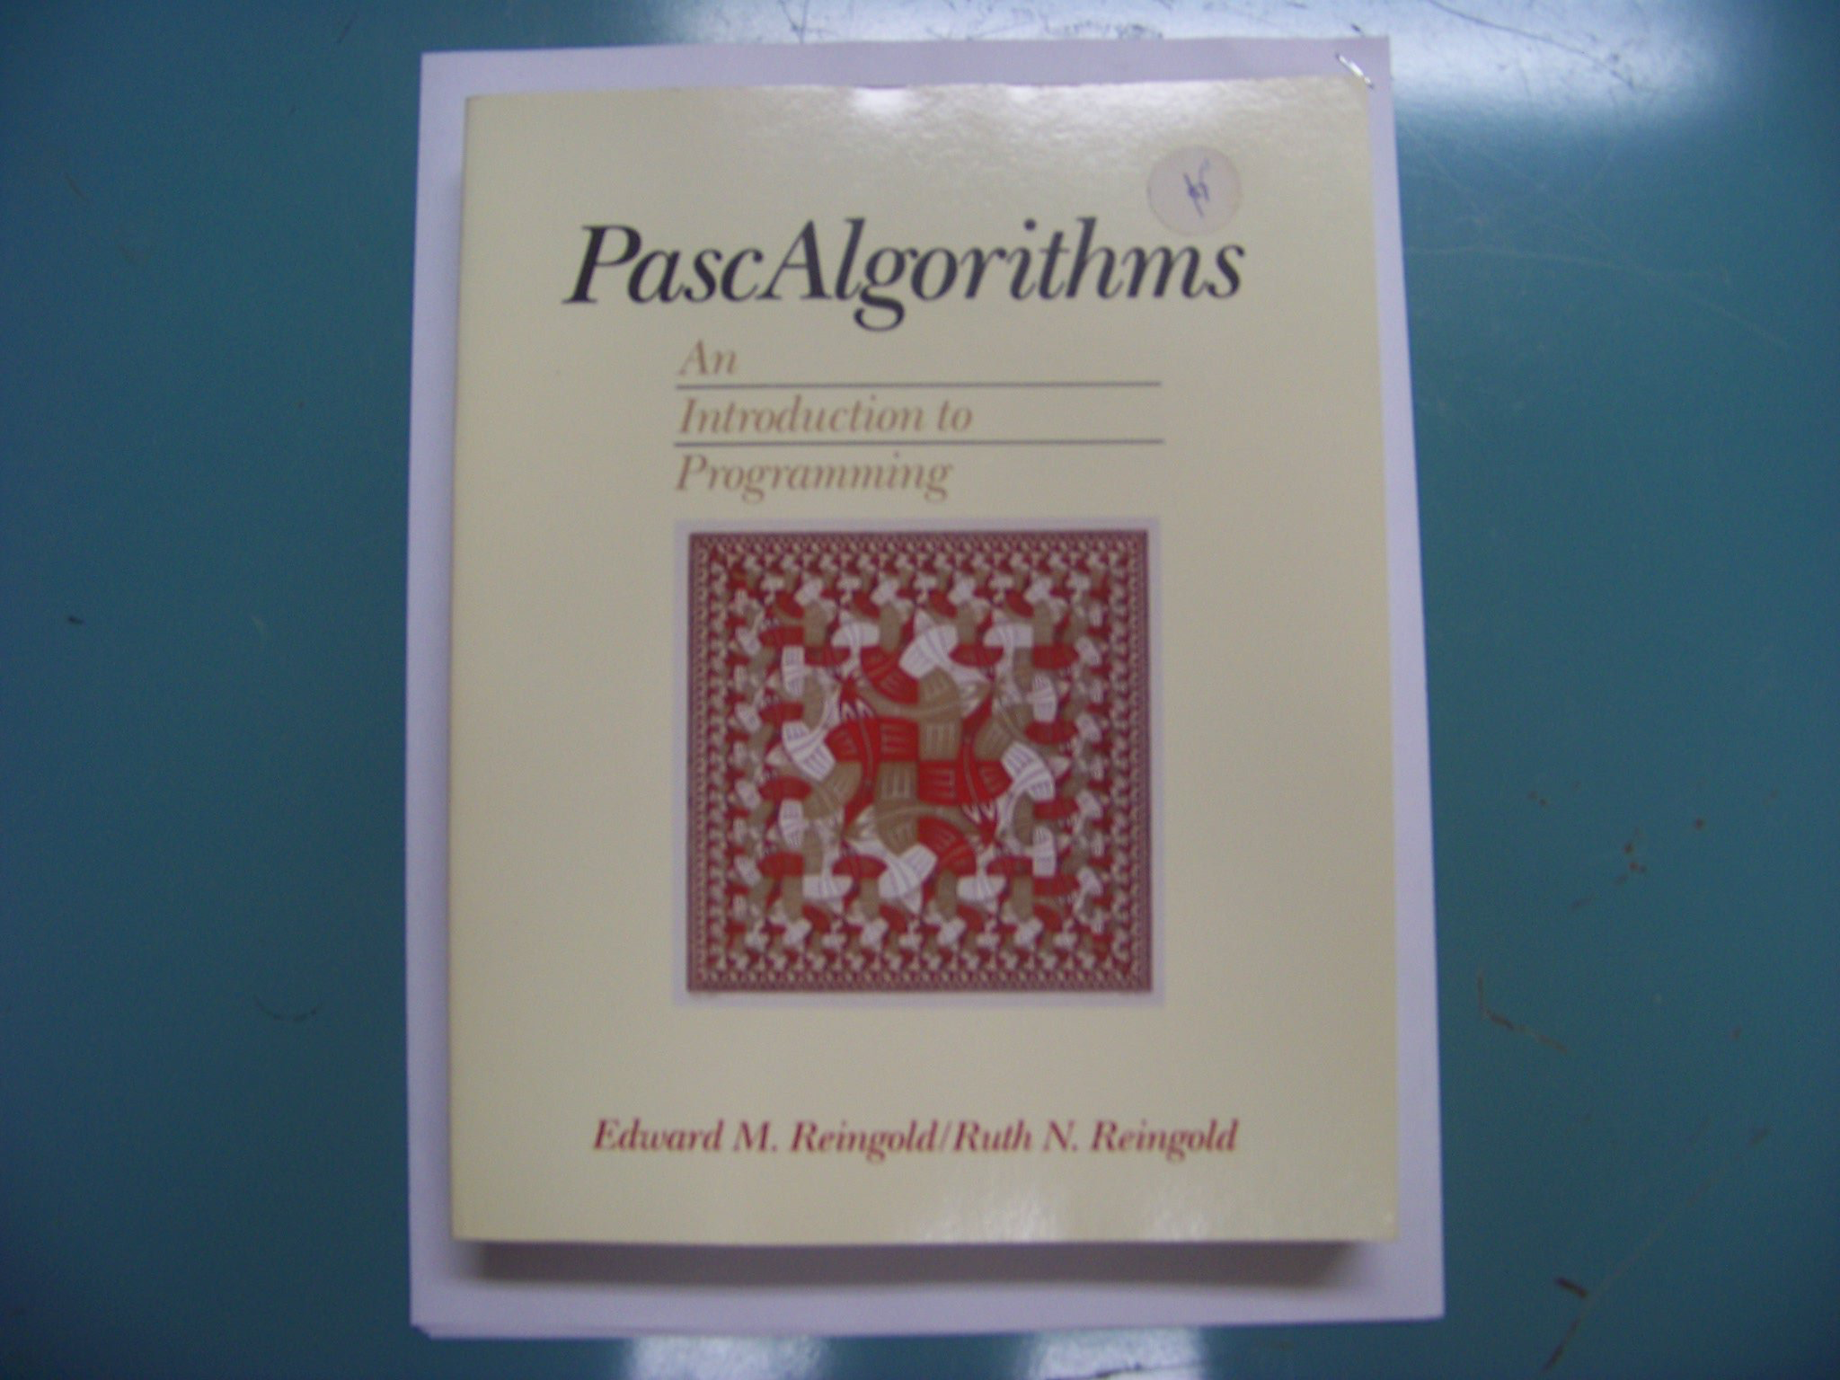

Slide 7
program Hello;
begin
writeln ('Hello, world.')
end.

Slide 8
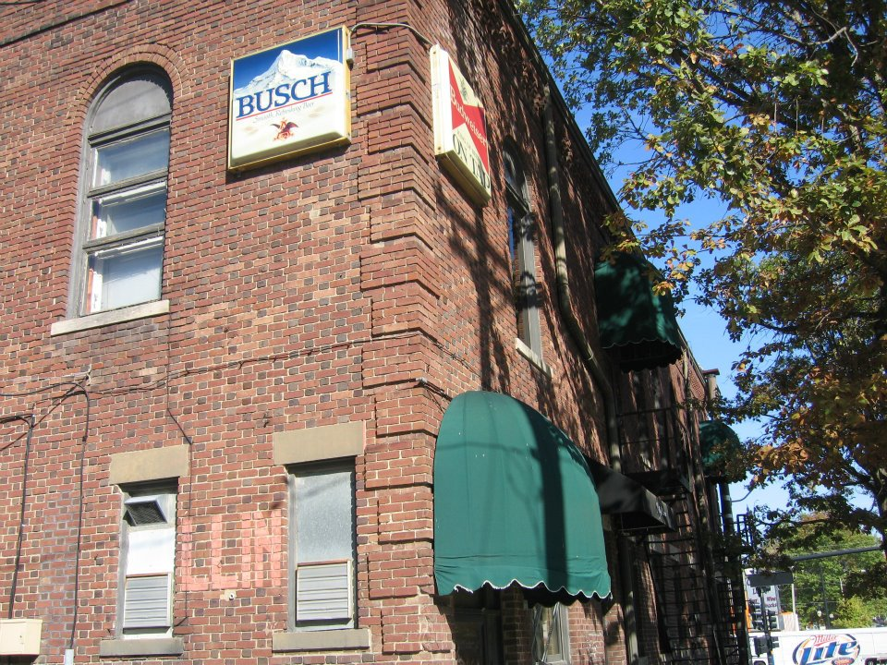

Slide 9
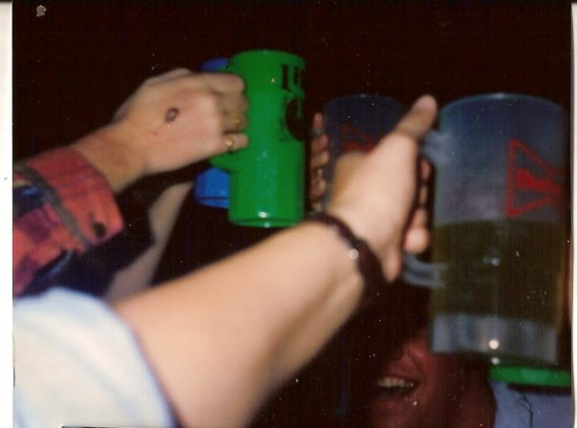

Slide 10


Slide 11
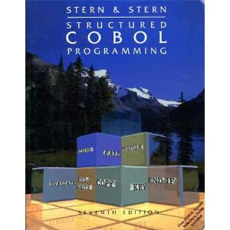

Slide 12
000100 IDENTIFICATION DIVISION.
000200 PROGRAM-ID. HELLOWORLD.
000300
000400*
000500 ENVIRONMENT DIVISION.
000600 CONFIGURATION SECTION.
000700 SOURCE-COMPUTER. RM-COBOL.
000800 OBJECT-COMPUTER. RM-COBOL.
000900
001000 DATA DIVISION.
001100 FILE SECTION.
001200
100000 PROCEDURE DIVISION.
100100
100200 MAIN-LOGIC SECTION.
100300 BEGIN.
100400 DISPLAY " " LINE 1 POSITION 1 ERASE EOS.
100500 DISPLAY "Hello world!" LINE 15 POSITION 10.
100600 STOP RUN.
100700 MAIN-LOGIC-EXIT.
100800 EXIT.

Slide 13
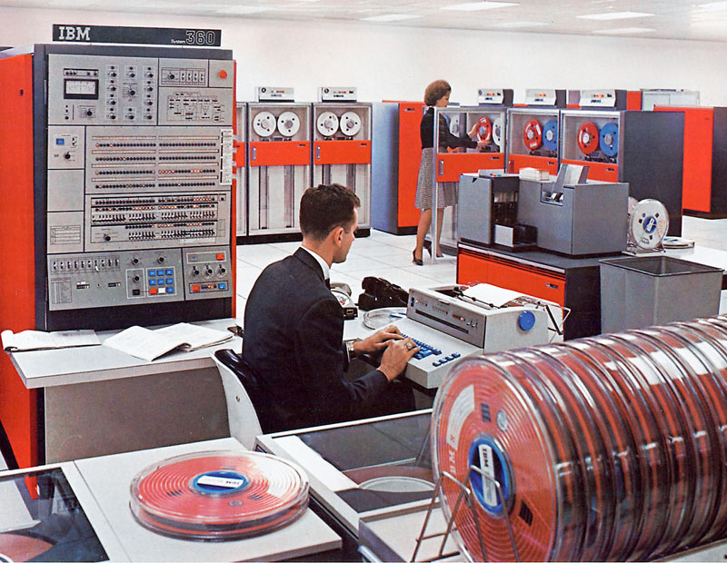

Slide 14
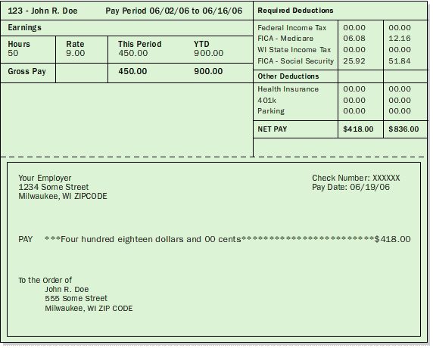

Slide 15
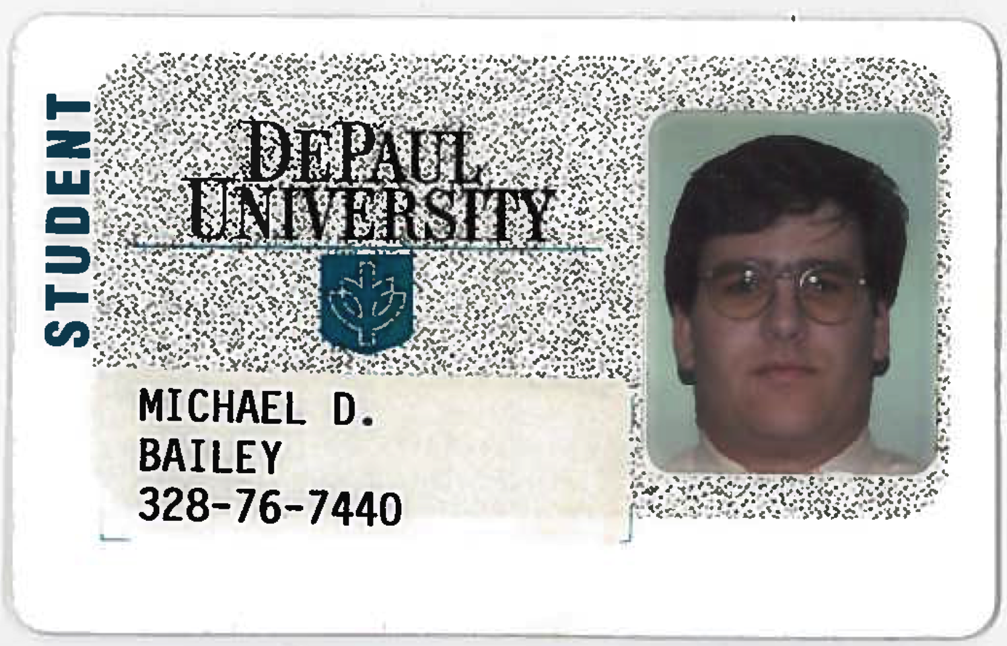

Slide 16
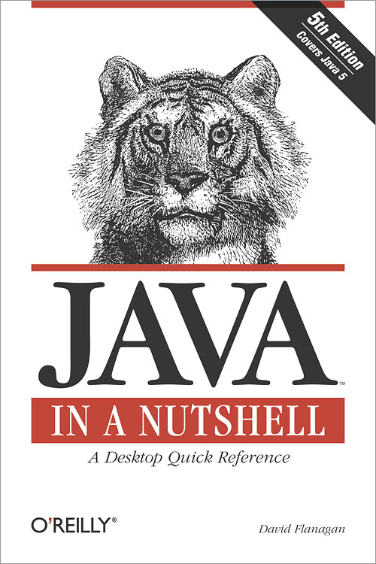


Slide 17
public class HelloWorld {
public static void main(String[] args) {
System.out.println("Hello, World");
}
}

Slide 18


Slide 19
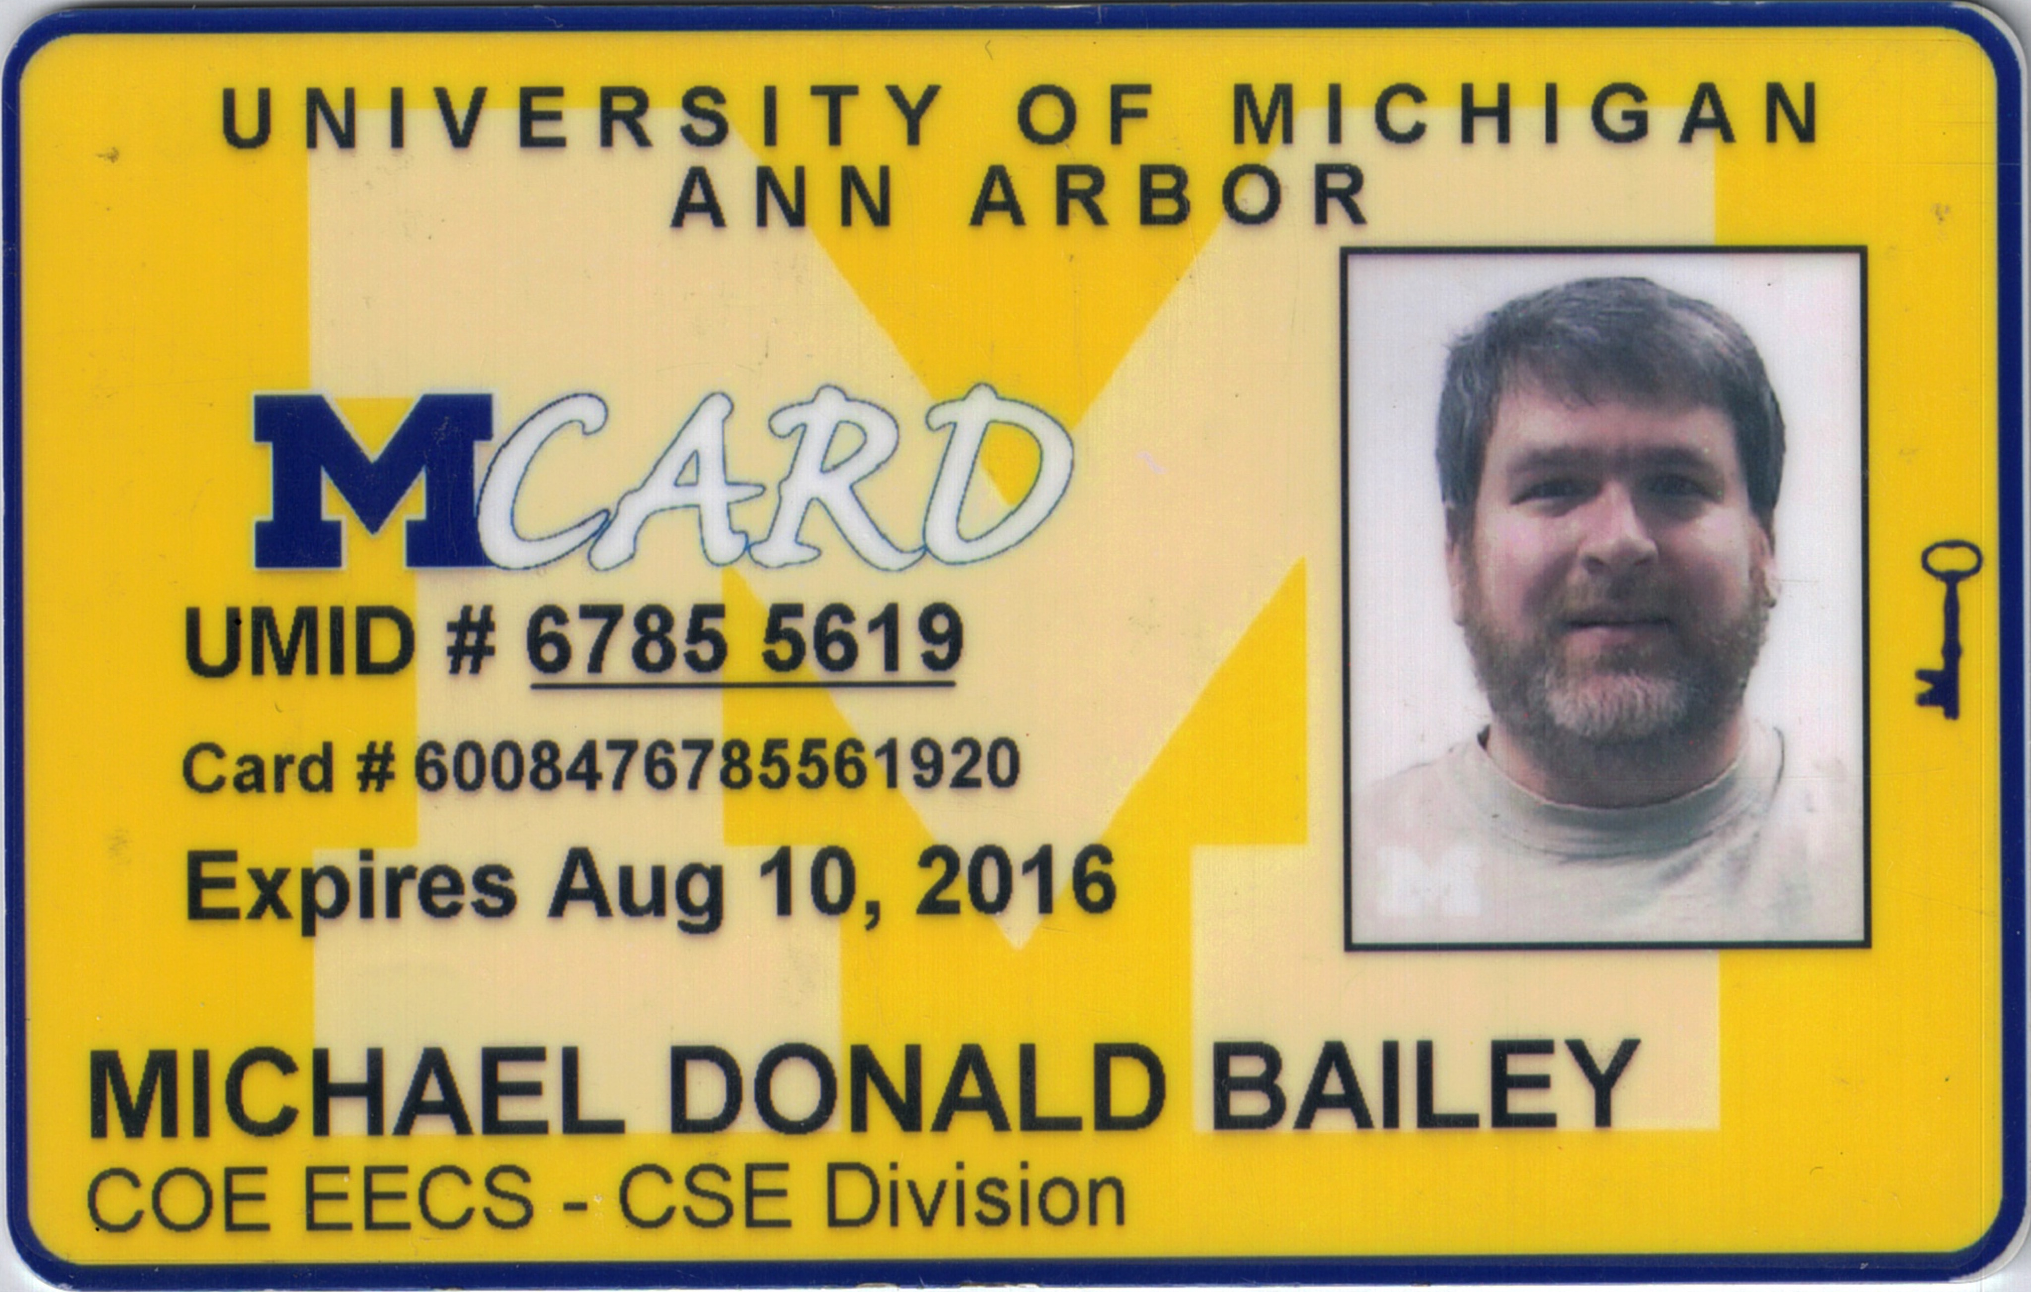

Slide 20
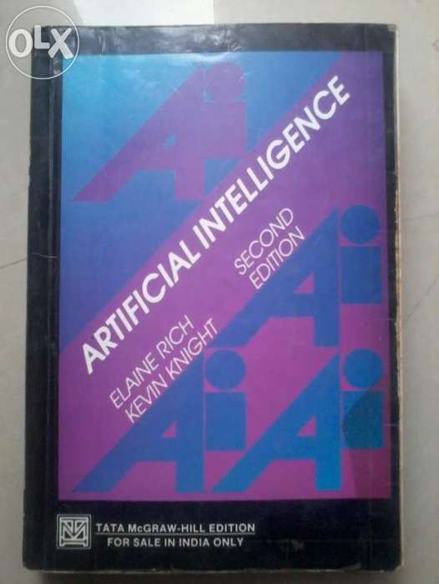

Slide 21
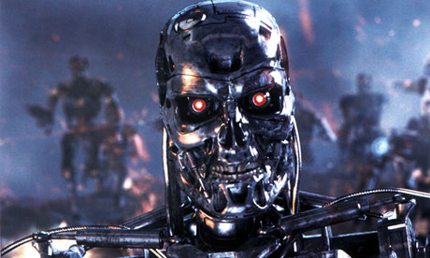

Slide 22


Slide 23
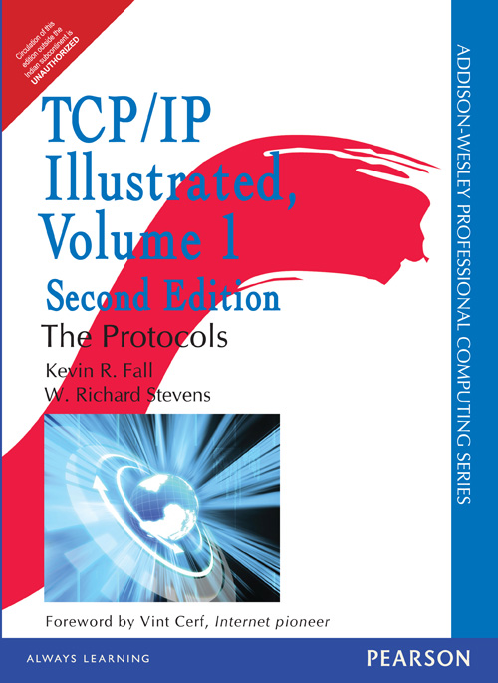

Slide 24
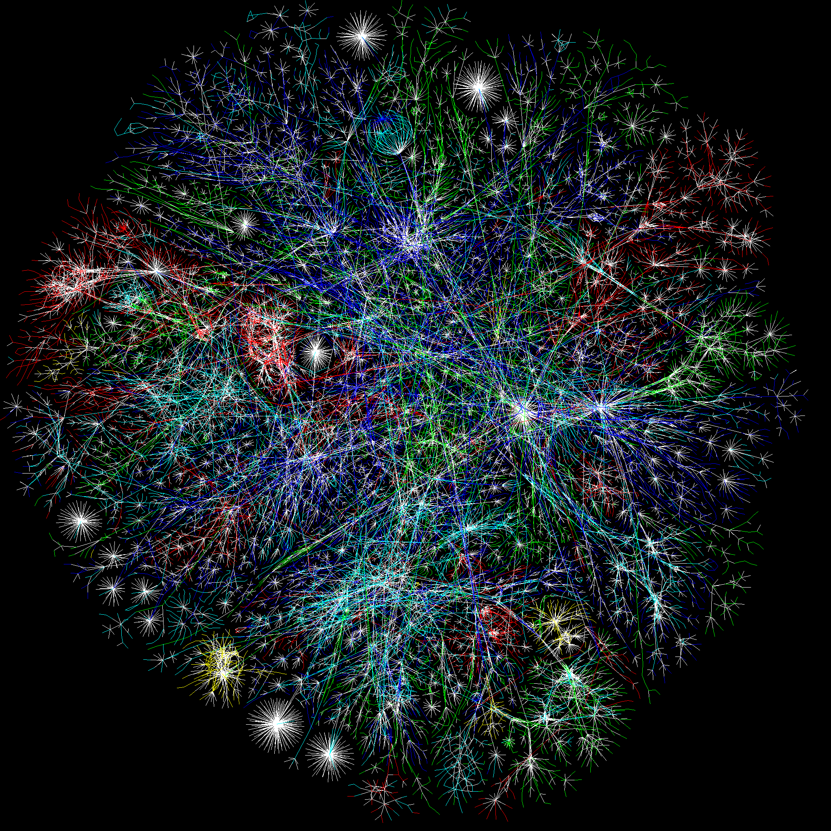

Slide 25


Slide 26
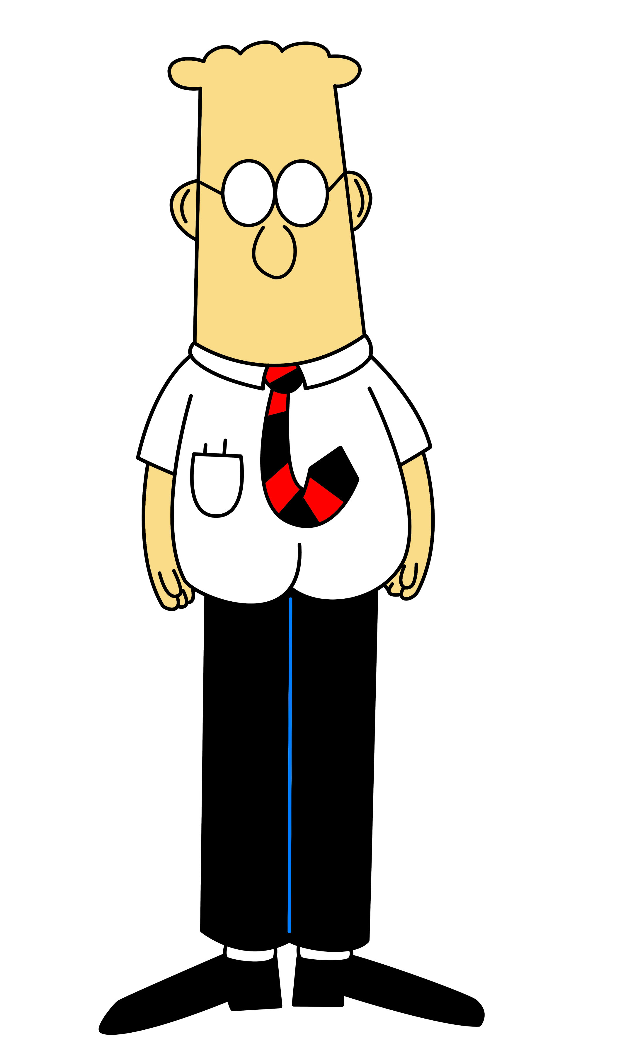

Slide 27
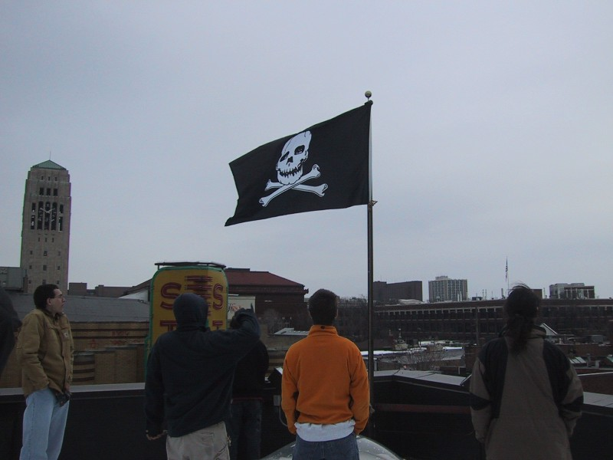

Slide 28
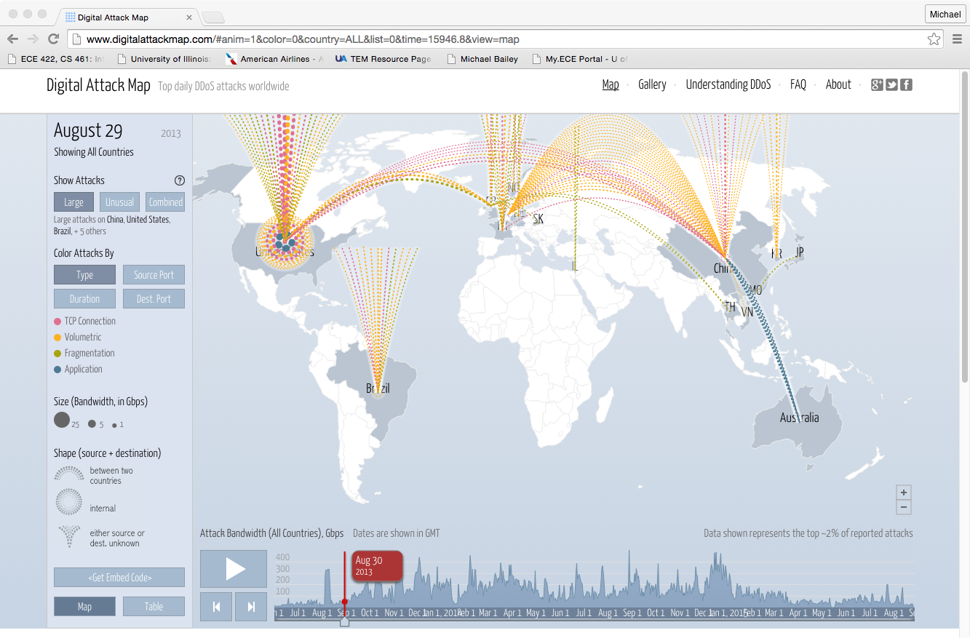

Slide 29
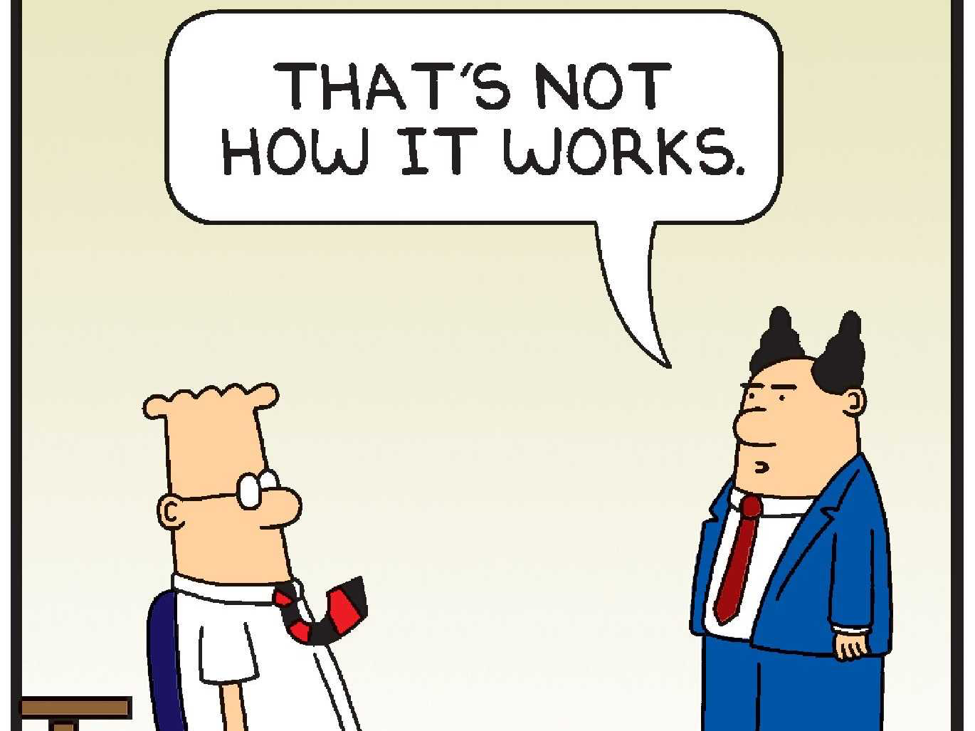

Slide 30
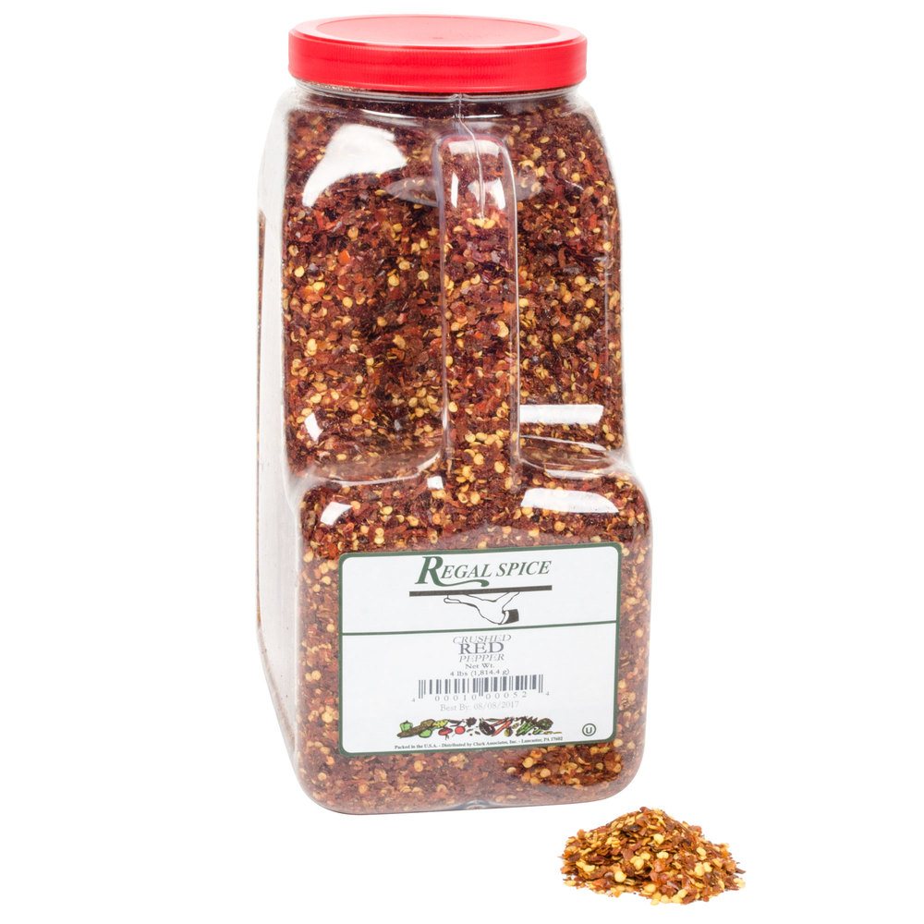

Slide 31
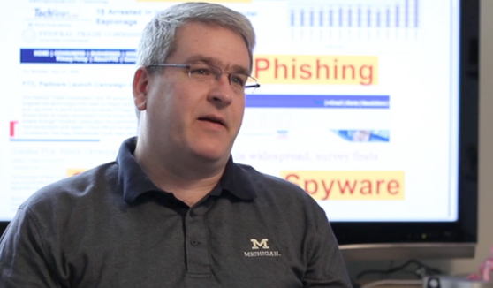

Slide 32
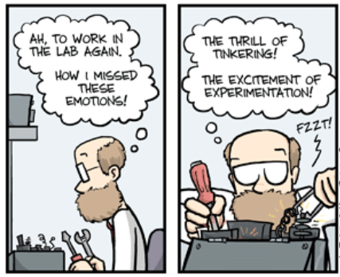

Slide 33
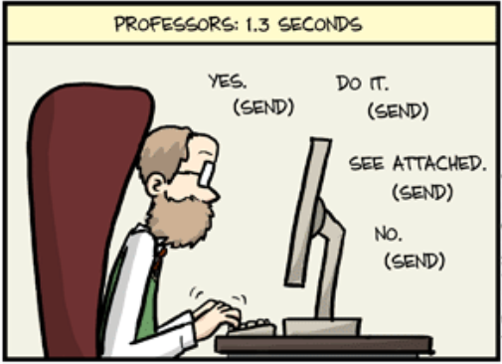

Slide 34
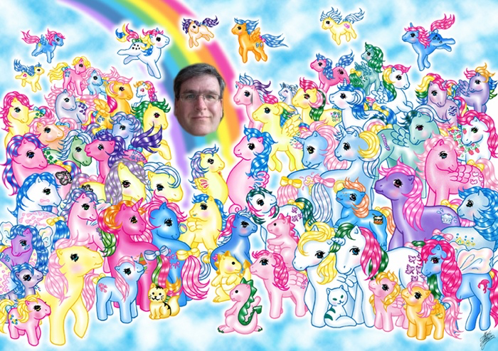

Slide 35
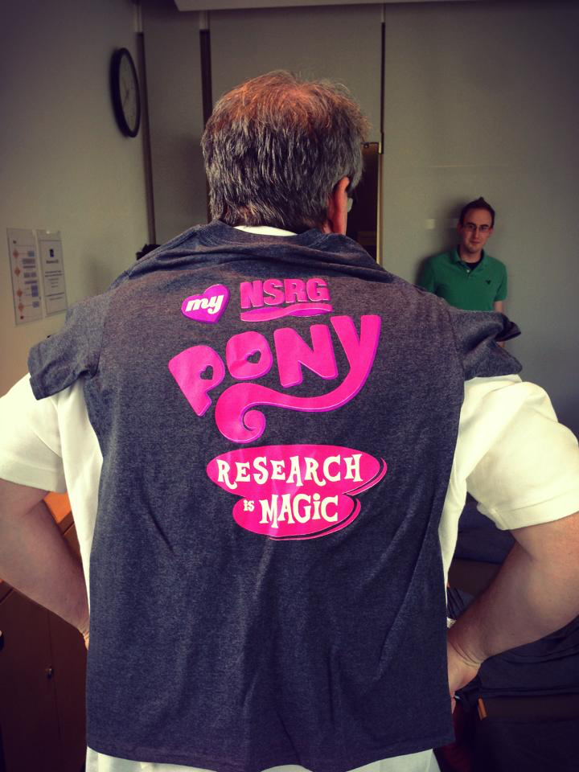

Slide 36
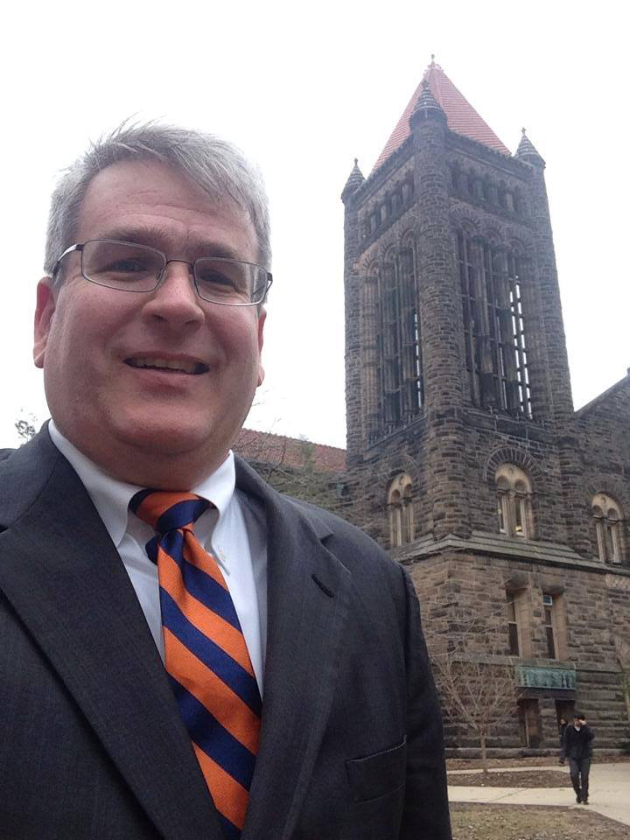

Slide 37








Slide 38
